Slide 1
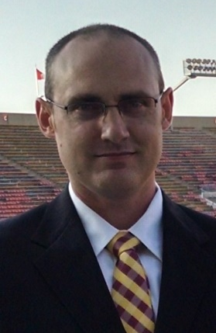
Computer Vision w/ Raspberry Pi
Setting up a Raspberry Pi for image processing
Evan Hennis
Google Developer Expert in Machine Learning
@TheNurl
https://eckronsoftware.wordpress.com
https://github.com/ehennis
YouTube: Evan Hennis

Slide 2
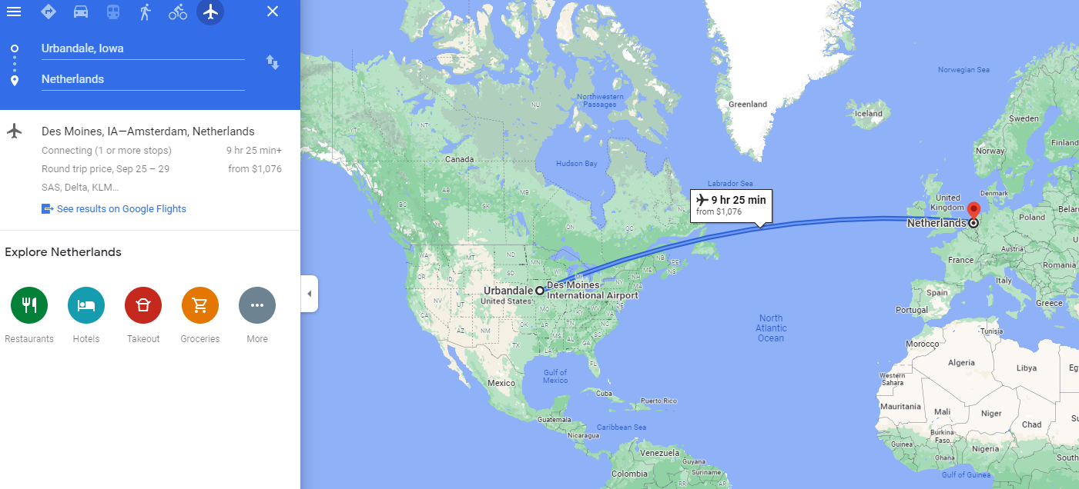



Bio
BS from Iowa State 2004
MS from Georgia Tech 2018
C# developer since 2004
GDE in Machine Learning 2019

Slide 3
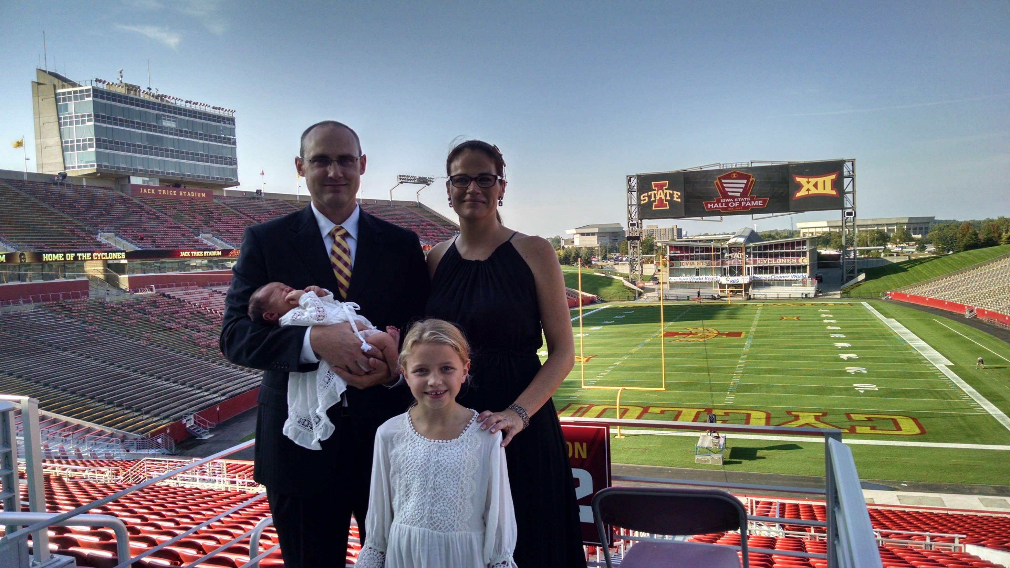

Slide 4
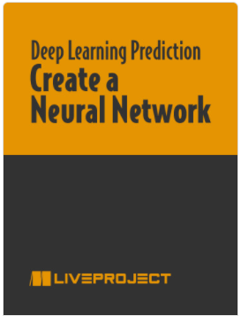
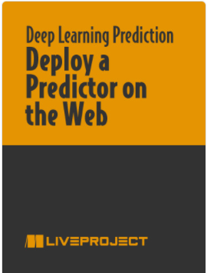
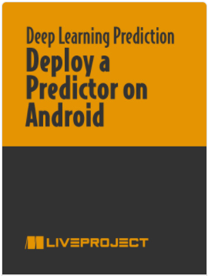
Deep Learning for Basketball Scores Prediction
https://www.manning.com/bundles/deep-learning-for-basketball-scores-prediction-ser

Slide 5
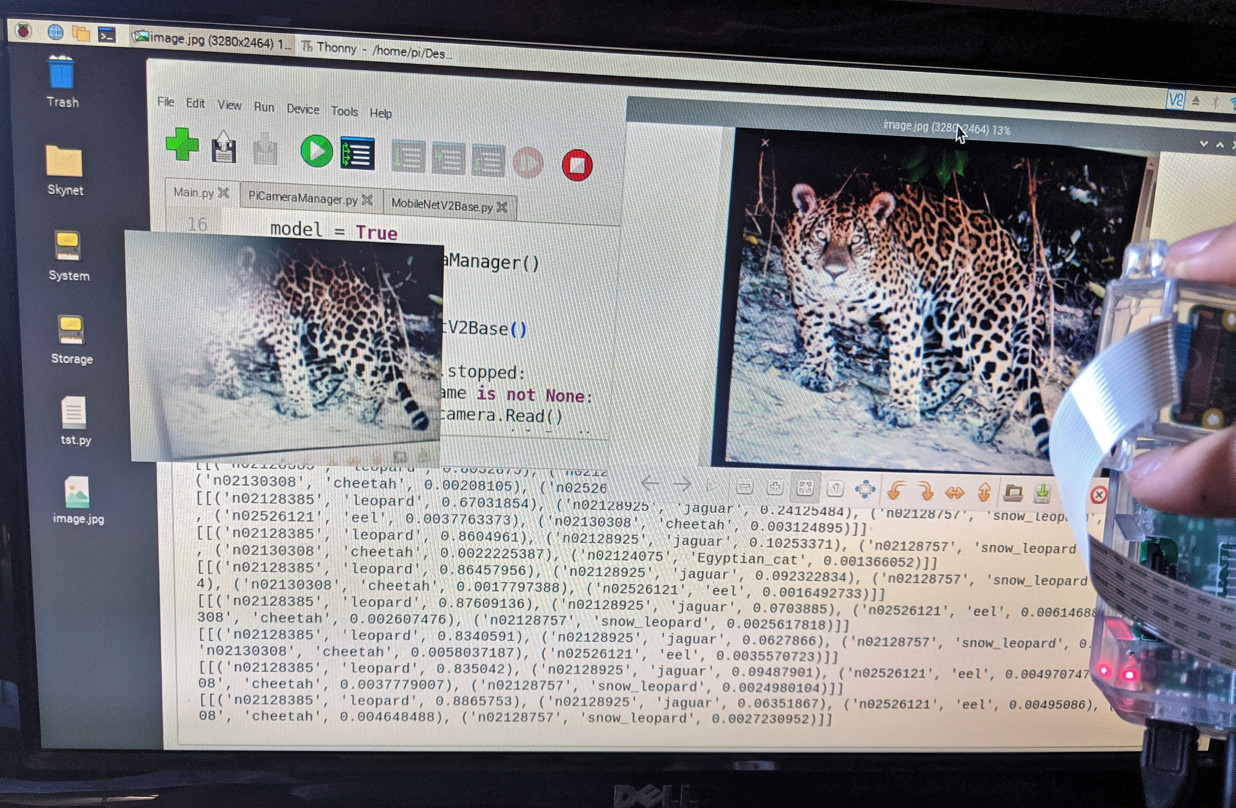
Overview
Project Introduction
Raspberry Pi Setup (SD and OS)
Camera and API
TensorFlow v2 on ARM
MobileNetV2
Code and Demo
TensorFlow Lite Update
Future Projects
Conclusion

Slide 6
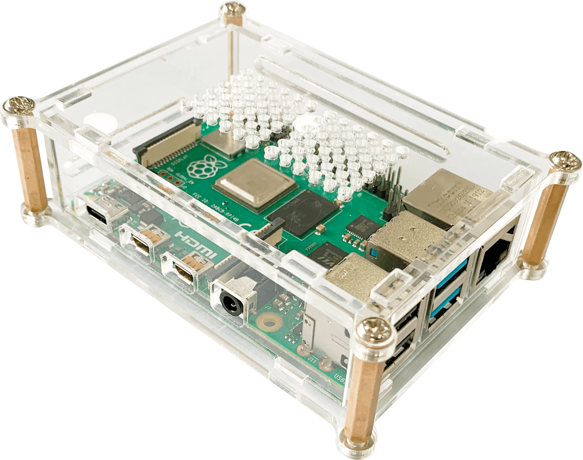
Project Introduction
Raspberry Pi 3
Raspbian (Now Raspberry Pi OS)
Raspberry Pi Camera Module V2-8 Megapixel
Leigh Johnson (@grepLeigh)

Slide 7
Raspberry Pi Setup (SD, OS, Camera)
SD Card
>= 8GB
Raspberry Pi Imager (I used Windows)
Don’t:
> 32GB
Write protect your card
Raspberry Pi OS (Former Raspbian) or Noobs

Slide 8
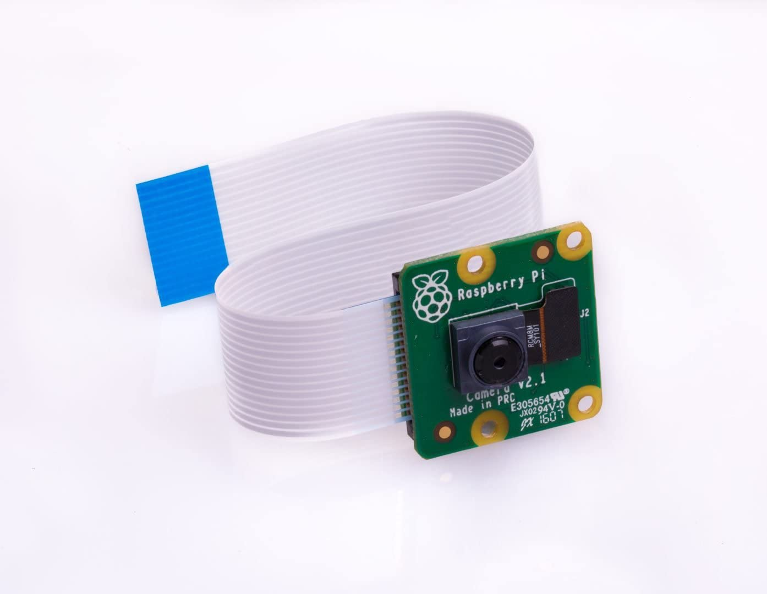
Camera and API
Camera: V2 8 Megapixel
API: PiCamera
sudo apt install python3-picamera

Slide 9
TensorFlow v2 on ARM
TensorFlow v2 doesn’t support ARM
TensorFlow Lite is preferred going forward
I use this on my Android application and it is pretty smooth
TensorFlow 2 ARM WHL: https://github.com/lhelontra/tensorflow-on-arm/releases

Slide 10
MobileNetV2
Built into Keras
tensorflow.keras.application.mobilenet_v2
Version 3 is out

Slide 11
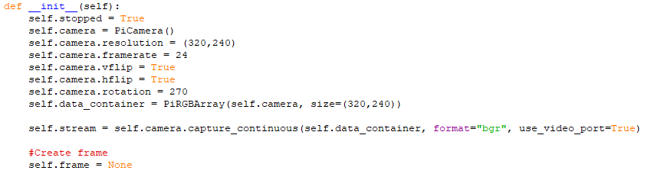
Camera Code (Initialization)
Notes:
Create the camera, set the resolution, set the frame rate (can increase with better hardware), create data container to hold the image, start the stream.

Slide 12
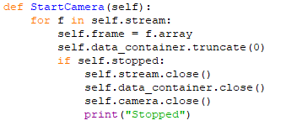
Camera Code (Stream)
Notes:
[Done in different thread] Grab the frame from the stream and clear the container

Slide 13
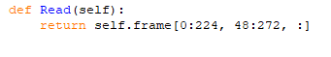
Camera Code (Read)
Notes:
Return the image data from the frame filled during the stream earlier

Slide 14

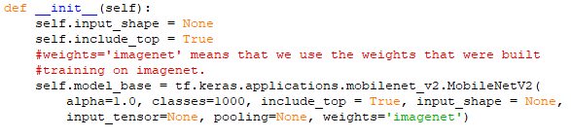
MobileNet (Initialize)
Notes:
Grab MobileNetV2 from the Keras library
Create the model from the keras collection. Setting the input variables. ‘imagenet’ is the trained weights

Slide 15
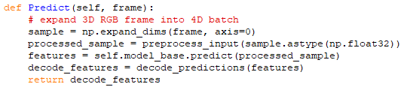
MobileNet (Predict)
Notes:
Convert frame to batch. Call preprocess_input from the Keras library. Predict the features. Call decode_predictions from the keras library.

Slide 16
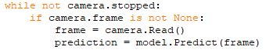
Main
Notes:
Grab the frame from the camera class and pass to the prediction method

Slide 17
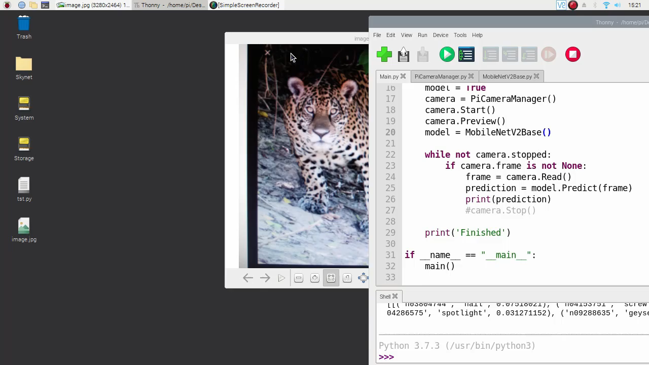
Demo

Slide 18
TensorFlow Lite
Convert Keras model to TF Lite Model
Link: https://github.com/ehennis/Blog/blob/master/ImageDetection/ConvertToLite.ipynb
Install TensorFlow Lite subset
Create TF Lite Interpreter

Slide 19
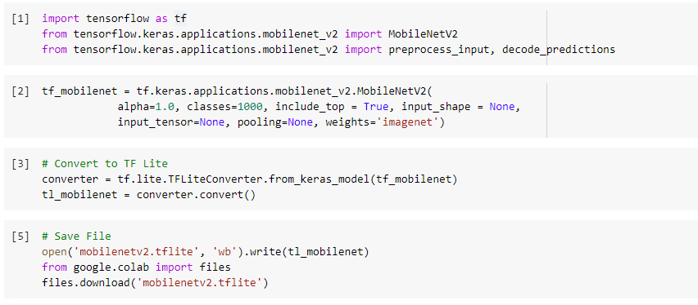
TensorFlow Lite (Model Conversion)

Slide 20
TensorFlow Lite (Install)
Follow Guide: https://www.tensorflow.org/lite/guide/python
For the Raspberry Pi
pip3 install https://dl.google.com/coral/python/tflite_runtime-2.1.0.post1-cp37-cp37m-linux_armv7l.whl

Slide 21
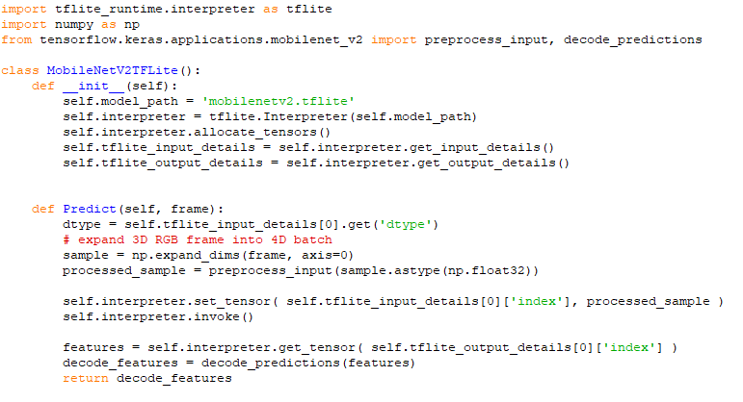
TensorFlow Lite (TF Lite Interpreter)
Notes:
Load the saved TF Lite model. Create the Interpreter. Load the input and output details. To predict, set the tensors and get the tensors.
NOTE: I am still using the preprocess_input and decode_predictions

Slide 22
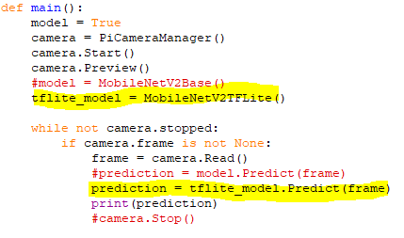
TensorFlow Lite (TF Lite Main)
Notes:
Calls are all the same from the Main class

Slide 23
Future Projects
Use transfer learning and train on a subset of images
Family pictures, cars, etc.
Implement object tracking for security cameras
Add to an automated home to turn the lights on when you show up
Really dumb but someone online added a Pi to his clock so that if anyone was looking at the clock it would jump off the wall
Anything…

Slide 24
Conclusion
Simple (Pretrained model, easy installs, and quick results)
Cheap ($35 Pi, $30 camera, $ SD card)
Easy (I was able to do it)

Slide 25
Links
Leigh Johnson’s Project: https://towardsdatascience.com/portable-computer-vision-tensorflow-2-0-on-a-raspberry-pi-part-1-of-2-84e318798ce9
Camera Api: https://picamera.readthedocs.io/en/release-1.13/
TensorFlow 2 ARM WHL: https://github.com/lhelontra/tensorflow-on-arm/releases
MobileNetV2 Paper: https://arxiv.org/abs/1801.04381
MobileNet Classes: https://gist.github.com/yrevar/942d3a0ac09ec9e5eb3a
Code Repository: https://github.com/ehennis/Blog/tree/master/ImageDetection

Slide 26
My Information
Twitter: @TheNurl
GitHub: https://github.com/ehennis
YouTube: Evan Hennis
Blog: http://blog.eckronsoftware.com
Email: EvanHennis@gmail.com
Manning liveProject: https://www.manning.com/liveproject/using-deep-learning-to-predict-basketball-scores
Manning liveProject Series: https://www.manning.com/bundles/deep-learning-for-basketball-scores-prediction-ser

